Slide 1
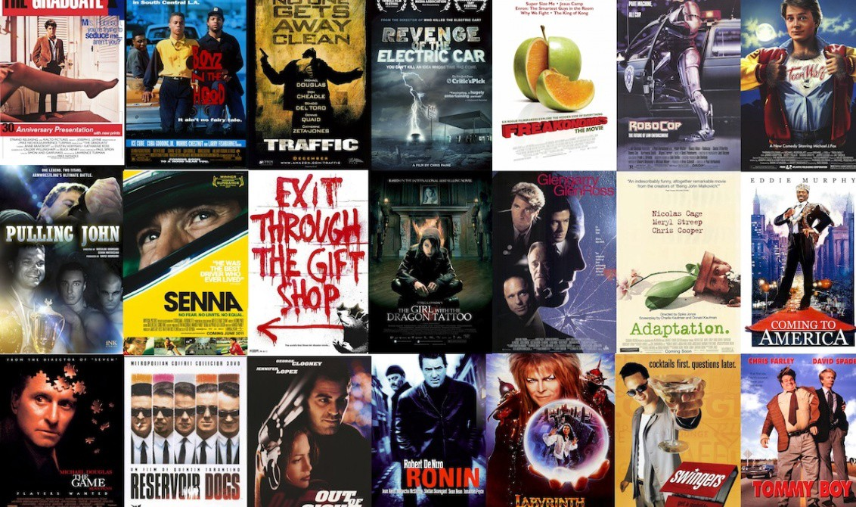
Movie Recommendation System
Team Members:
Doruk Gürsey
Kaan Önder
Kemal Berke Saka
Önen Emre Can
Advisor:
Dr. Abdül Kadir GÖRÜR

Slide 2
Movie Recommendation System
Definition: A web application that has thousands of movies in its database that users can rate movies and get recommendations based on their ratings.
Main Features:
Predicting movies that users might enjoy.
Rate(Like) feature for registered users about movies.
Display and search among the database of movies.
Constraints: Our dataset contains of limited amount of movies(5000 movies)

Slide 3
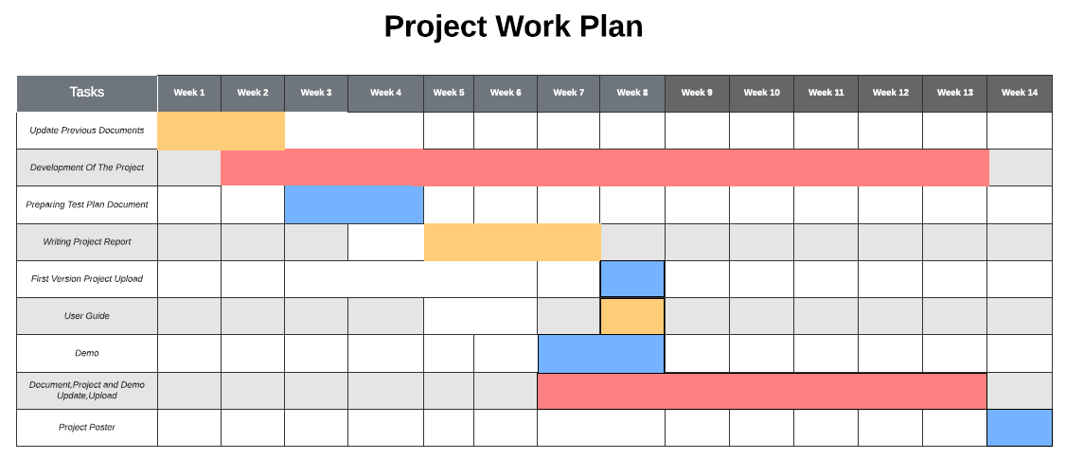

Slide 4
Workplan
Tasks | Done By
Tests | Berke-Önen
Front-end | Doruk-Önen
Back-end | Kaan-Doruk
Recommendation Algorithm | Kaan
Dataset Modification,Arrangement | Kaan-Berke

Slide 5
Similar Projects
Project | Item-based Recommendation | Basic Filtering
MovieLens | Yes | Yes
suggestmemovie | No | Yes
IMDB | Yes | Yes
Movie Recommendation System | Yes | Yes
Rotten Tomatoes | No | Yes

Slide 6
Success Criteria And Results
Success Criterion | How To Measure | Results
Accuracy Of Movie Recommendations | By manually checking the contents of the recommended movies. | Recommendations are quite accurate and sensible.
Apply Efficient Prediction Algorithms | Testing the algorithms, user feedback | Prediction algorithms we used works fine but a little slow.
Simple And Responsive Interface | By checking user feedback. | System’s interface is easy to use and mostly responsive.
Provide Reliable Data | Analyzing and testing the data. | Most of the data we use are decent.But there are exceptions.

Slide 7

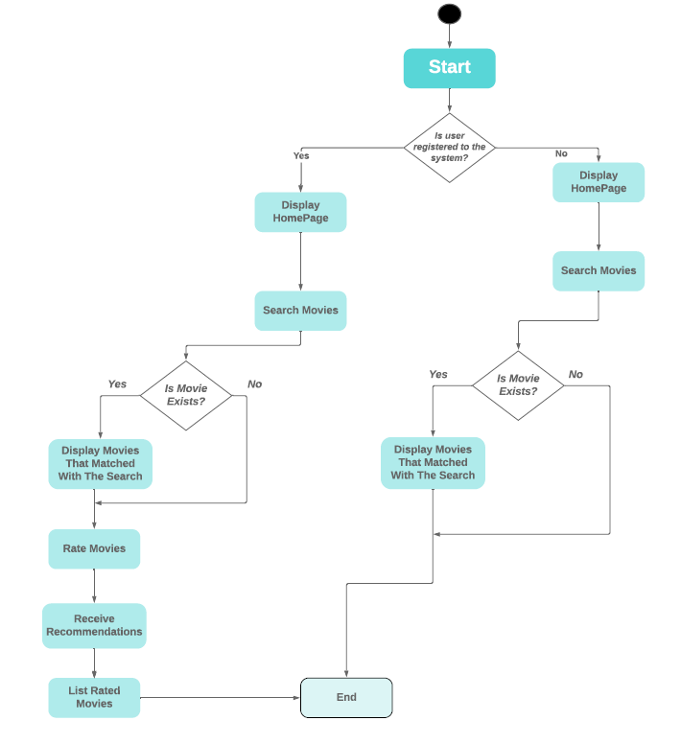
Activity Diagram

Slide 8
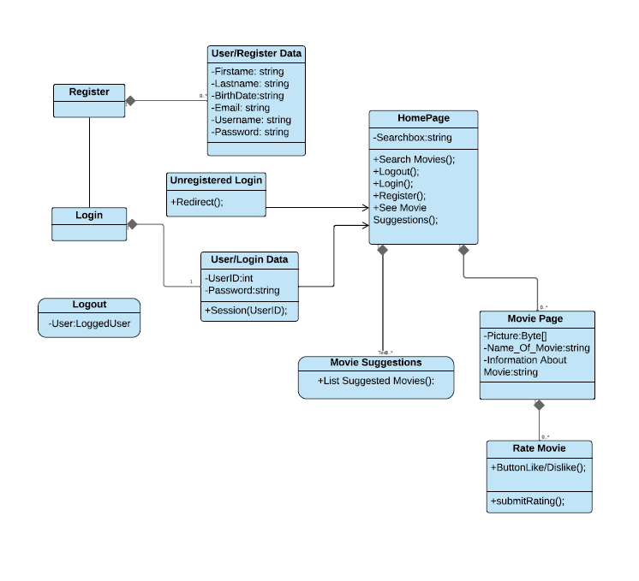
Class Diagram

Slide 9
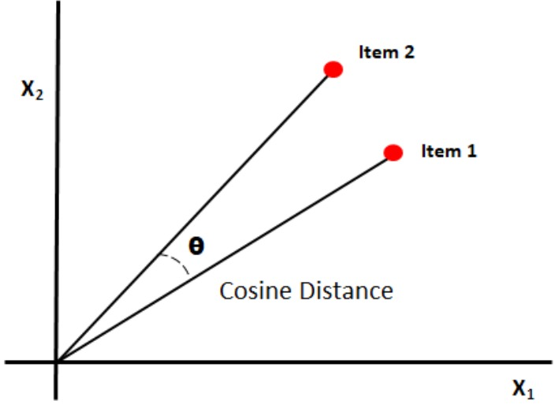
Cosine Similarity

Slide 10




Technology Used
Python
Django
jQuery
SQLite

Slide 11
Potential Risks And Outcomes
Risk | Impact | Solution | Outcome(Results)
Irrelevant recommendations provided from the system. | Lack of system’s main goal. | Search for other prediction algorithms and make improvements on them | Movie predictions are quite decent based on user ratings.
Website Crashes,Bugs,etc. | Causes system to malfunction. Unable to use. | Finding the cause of these problems and debug ,solve them | Some of the data that dataset have are not quite valid.(Thousands of movies and information about them).Some could have misinformations.

Slide 12
Project Screenshots

Slide 13
Project Screenshots

Slide 14
Project Screenshots

Slide 15
Conclusion
In conclusion, we developed a web application that people can use it for discovering new movies either by traversing through categories or specifically search for them.
Also, they could find similar movies that they like by rating(liking) various movies in the system.

Slide 16
Thank You!

